Slide 1
Also Known AS: How To Do Something With Your Phone That’s Actually Productive

Slide 2
TODAY’s ADVENTURE:
What the Heck is an RSS Feed?
R S S

Slide 3
RSS Stands For Which of the Following?
Regionally Selected Signal
Really Stupid Skunks
Radio Standard Signal
Rich Site Summary
Referenced Secure Site
All of the above

Slide 4
RSS
An RSS feed is when your phone subscribes to one or more web sites to receive their latest updates as they happen.
Kind of like how your Twitter feed updates continually as people you subscribe to tweet their useless blah blah blahs, the RSS feed presents new information published on the web sites/blogs that you subscribe to, whether that be one site or a hundred.

Slide 5
RSS
There are several different apps you can install to run RSS feeds. Feel free to uninstall later on and replace this, but right now we are all going to go to our phone/tablet’s app store
Yep, as in right this second—GO THERE!
Search for the app called feedly
Install it

Slide 6
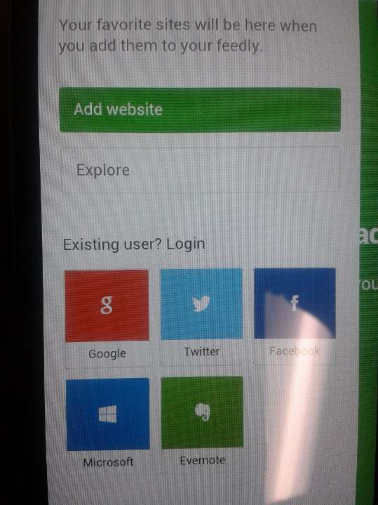
FEEDLY
There should be a drop down menu at the top of your screen. Tap it, and then select the option to add a website.

Slide 7
FEEDLY
The site info you need to add our class blog is: bghs3.weebly.com/1/feed (leave off the http:// and don’t type www)
Now, keep in mind that this gives you a simplified update on new posts that are added to the blog. It is not the full web site, only a feed on posts. What it is, though, is QUICK.
You will be asked to connect the app to some account like facebook, google, etc.

Slide 8
REMEMBER:
Having a cell phone or tablet or any personal electronic device in this classroom is a privilege, not your right.
That means you are allowed to have a phone out because Mr. Tucker allows it.
Cell phone permission is not so you can screw around instead of learning. It is so electronics can be used to help learning.
That means you install an app and keep it on there if instructed to do so. (And use the thing to enhance your classroom experience.)

Slide 9
BUT…
“It’s MY phone. You don’t pay my cell phone bill. You can’t tell me what apps to install on my own phone!”
Yes, and it’s MY classroom. If you don’t want to play by my rules, then don’t have your cell phone out when you are in my classroom.
EVER!

Slide 10
YOUR PHONE…
MY CLASSROOM
If You’re Curious, See Who Wins

Slide 11
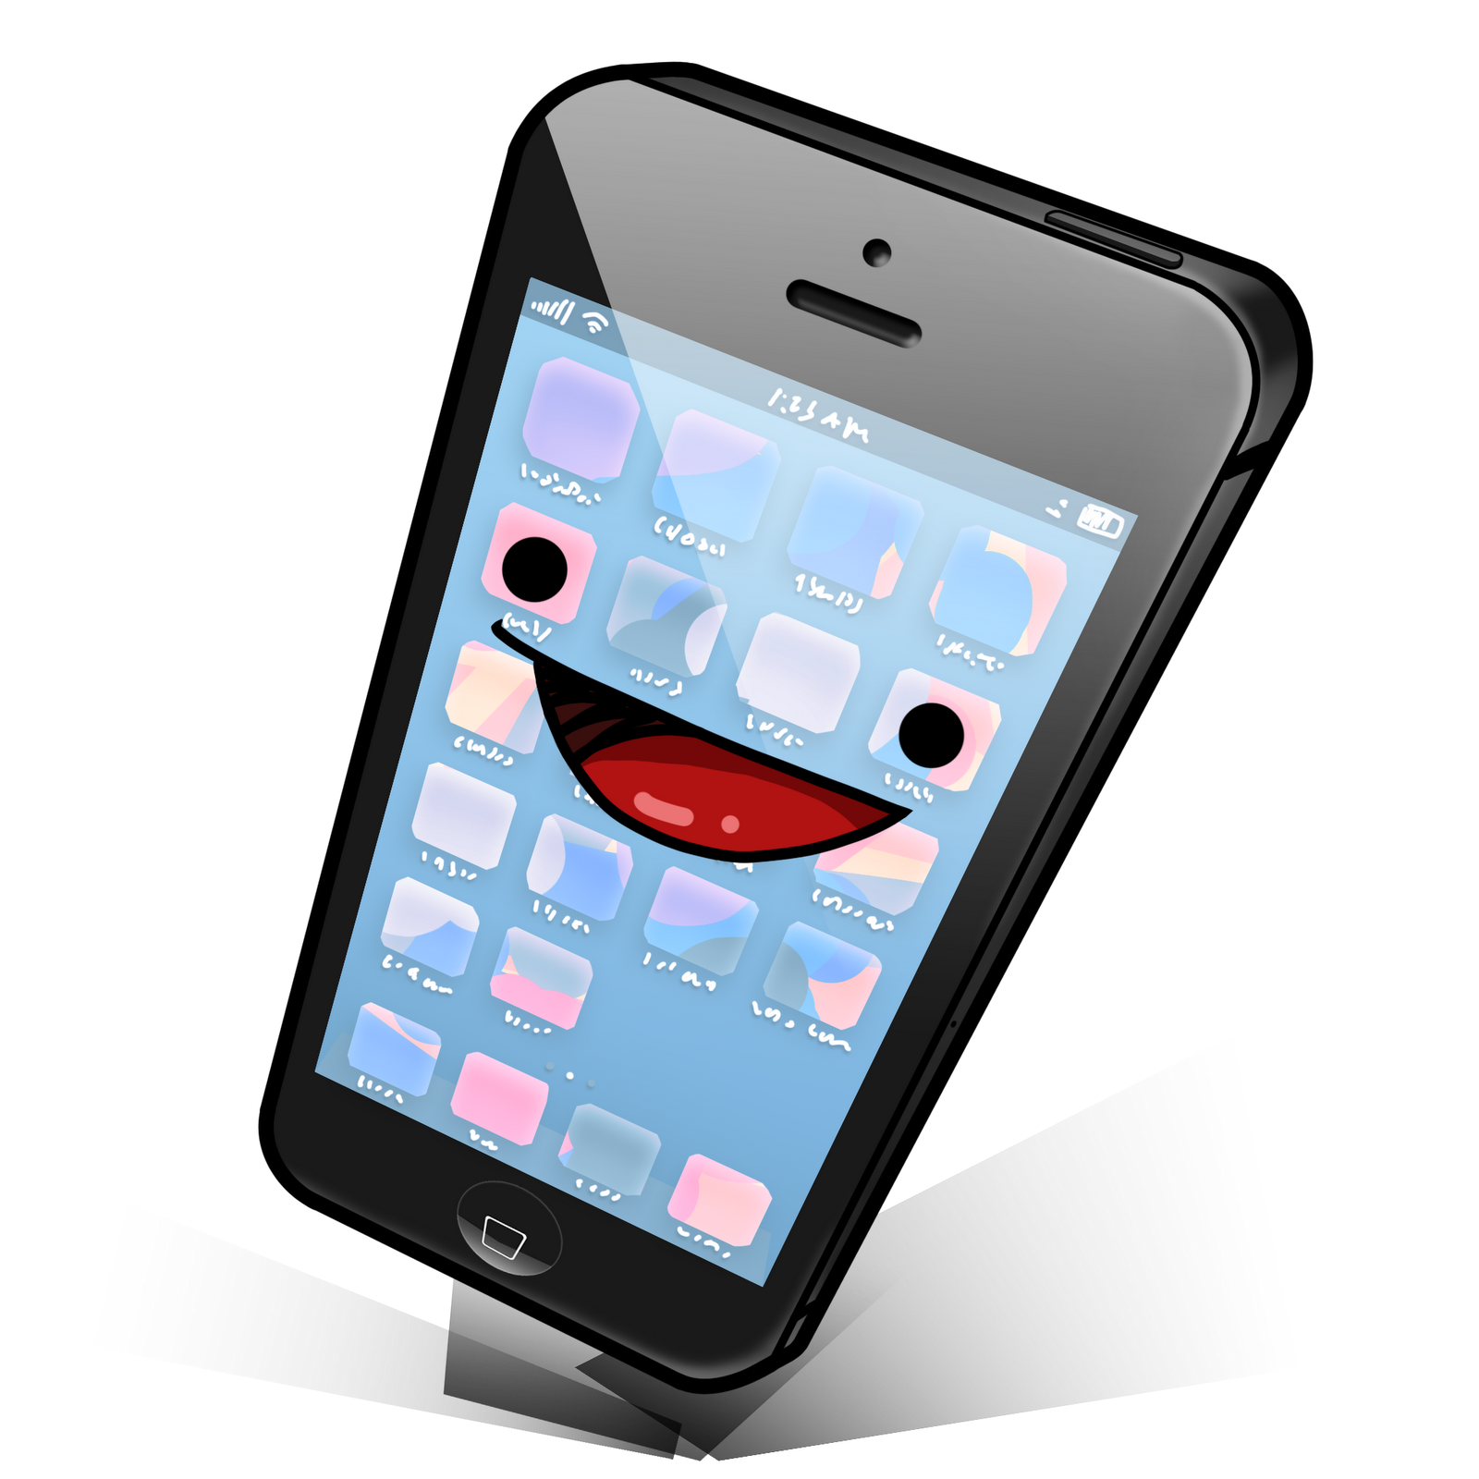
NOW…
Let’s
All
Be
Happy
Cell Phone
Owners!

