Slide 2
Oh Yeah…
It’s time to talk about the topic you’ve all been waiting for:

Slide 3
WHERE BABIES COME FROM!
Just Kidding…

Slide 4
THE JUNIOR RESEARCH PAPER!

Slide 5
Actually, It’s Called The Junior Research Project!
Yeah, we’re juniors. Yes, this project is bigger than just a paper. Yes, this project requires a lot of research. BUT--yes, you’ve already done a good deal of it!!! Now, this is not some old school research paper. It is some of that and beyond. Today, we are discussing an OVERVIEW…

Slide 6
FRET NOT…
Do not fall into some anxiety attack mode. This project is not that difficult. Actually, it is a pretty straightforward process if you just follow the steps given to you and stay on pace with the class. As mentioned on the previous slide—you already did some of the research needed for your project!

Slide 7
We are not going into all of the little details today, but here’s an run-through of the main points. The project will be divided into two main sections: 1) An informative/analytical ARTICLE based largely on research that you gather, and 2) a PERSONAL piece that focuses largely on you.
Now, that’s the overview. We will get into a little of the fine details today, but for the most part we just want to cover the big picture. We are just edging into it now, and the real work gets started in the next couple weeks. So, let’s continue with the introduction. Our theme for the project will be universal, though the elements individual.

Slide 8
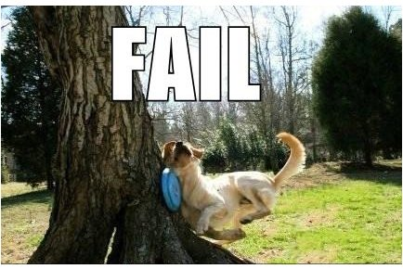
Our Theme?

Slide 9
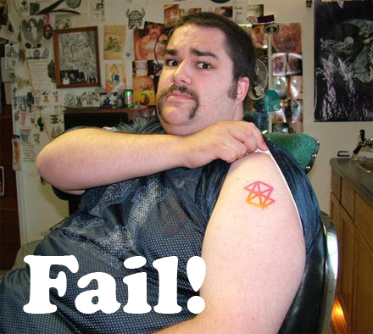

Slide 10
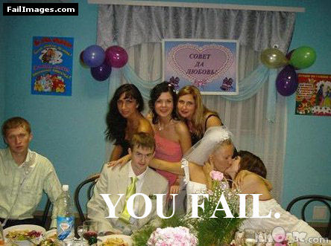

Slide 11
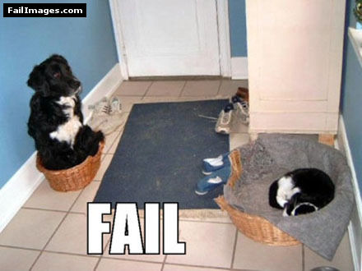

Slide 12
OK, “YOU FAIL” isn’t really the theme of our research project, but it is an element. Our overall theme for our project is: THE AMERICAN DREAM: DEGREES OF SUCCESS and FAILURE
You will be tying all of your sections of the project into this overall, unifying theme. No big deal, because we have already discussed this previously in class to some extent. Yep, some of the discussions and activities we have already done have been fuel (and resources) for this project. So, we already started this thing a long time ago and you didn’t know it. What we’re going to be exploring is the attainability of people’s ideas of success in pursuit of The American Dream…what exactly that may be and why many seem to fall short of their expectations.
The Two Main Sections…

Slide 13
The article will be the piece that probably requires the most work, and it is what resembles the traditional research paper more, so that’s what we’ll begin discussing first. The article is also the section that will be the most similar among all of us, as it’s the most directed. You will title it whatever you want, but the article’s focus will be on how difficult it can be to achieve the American Dream. Part of the article should pinpoint your generation’s views of success in society, as well as that of society in general, both present and past. You will need to research facts and also draw your own conclusions based upon those facts regarding success and the difficulty of “making it” in the real world today, especially in making it big. Yes, we will go into much deeper detail regarding the specifics of this tomorrow.
The personal section is probably the easiest part of the project, and is maybe where you should begin if you feel intimidated by the prospect of doing a big research project. Now, this is not some random “dear journal” type rambling—rather, it will be very focused, with some emphasis on your plans/life map for yourself, as well as some reflective writing.

Slide 14
ENGLISH LAB Dates:
APRIL 22
MAY 12
MAY 13
MAY 14
MAY 15
LIBRARY Dates:
MAY 18
MATH LAB Dates:
APRIL 24
APRIL 29
Chromebookie Dates: MAY 6
MAY 7
Dude—that’s up to ______ hours of in-class time to work on this thing!
NOTICE—these dates can be deleted at any time if you tell me you don’t need them

Slide 15
MOre INFO FOr YOu
Before you ever get started writing one word of your research project next week, remember this:
SECTION 1 is written in THIRD PERSON
SECTION 2 is written in FIRST PERSON
Unless it is part of a direct quote from some cited, do NOT use the pronouns I, me, we, us, our, or my in Section 1!!!!!

Slide 16
Section 1 will include the following:
An exploration of what it means to be successful (or an accomplished member of society) in America. What is The American Dream, both today and traditionally. While you may mention the past very briefly, the focus is on present day and on the USA. (So, be sure the statistics you mention anywhere in your article are American. We don’t care about the middle class in France or Peru or…)
A discussion of external factors that can potentially make reaching success a more difficult process in current day America. External would be things outside of an individual. Things that are beyond our direct control. Think environmental.
A discussion of the common internal factors that commonly keep people from reaching the success they could/should in life. Obviously, these are the things we have direct control over and derive from within.
An analysis of why the successful are able to reach (and maintain) their success. (What separates those who make it from those who don’t?)

Slide 17
SECTION 2 will include the following:
This half of your assignment is all about you. Still keeping with the theme nailed down in Section 1, here you discuss and map out your own personal plan for success in life (post-high school.) In detail, with specific information of course.
Introduce this section with a paragraph that identifies your own explanation of what success means to you, personally. A bit of philosophy and a bit of personal goals overview.
Identify a specific career you see yourself doing and share a thorough profile of that job. “The medical field” is not specific—“physical therapist” is. Owning your own business is not an option unless you have discussed and cleared with Mr. Tucker. Discuss why you are interested in this career and why you think you can be successful at it.
Identify the schooling/training that will be required to enter this field. Profile a place where you see yourself completing this. Refer to time and money required, and identify how it will be paid for.
Then, you will discuss other aspects of your adult life, such as where you want to live, family plans, hobbies, etc. In all of this, do keep in mind expenses and how those tie into the salary of your chosen career.
The specifics of this will come later, but you will have to include a personal (detailed) budget for yourself.

Slide 18
The Whole Shebang:
It must be presented in a 3-tab folder. If not, it will NOT be graded
It must be typed, with text at size 12 font, in a clean font that Mr. Tucker can and will read
Section 1 will be 1.5 spaced in a two-column format
Section 2 will be double spaced in regular paragraphs
There will be a main title page, a title page for section 1, and a title page for section 2
There will be a table of contents page that is placed directly after the main title page
Your pages, minus title pages, will be numbered and contain a header
The back of your folder will contain your bibliography
Citations will be in MLA format

Slide 19
YEAH, BUDDY!!!
If a lot of the things that have been covered in this slideshow sound familiar, that’s because you have already looked up a lot of this info and saved it in your OneNote folder…complete with sources!
On Friday, we will be moving pages from the Practice section into the Research Paper section! Cool, huh? Look at all the work you’ve already finished…

Slide 20
WHATYAGOTTAHAVE:
A minimum of 2 book sources
A minimum of 1 newspaper source
A minimum of 4 magazine sources
A minimum of 6 web sites
A Web Article is NOT a Magazine Article!!!!!
Online archives of print articles are NOT web sources!!!!!
KNOW THE DIFFERENCE!!!!!
http://www.kyvl.org/ is your friend!

Slide 21
The entire project is due by May 20!
A draft of either Section 1 or Section 2 is due on May 8!
You have ESS on TUES/THURS
Use MS Word, GoogleDocs, whatever you want, BUT the papers MUST match the exact format stated in the assignment! If not, your grade will suffer.
Come to school and keep up with our pace. I will NOT panic with you, nor will I bend to help you salvage your procrastination.

Slide 22
QUESTIONS COMMENTS COMPLAINTS?

