Slide 2

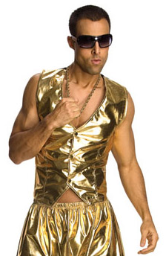
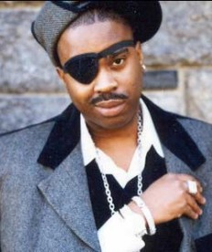
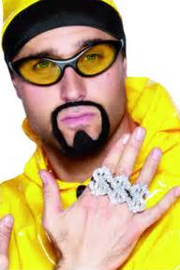
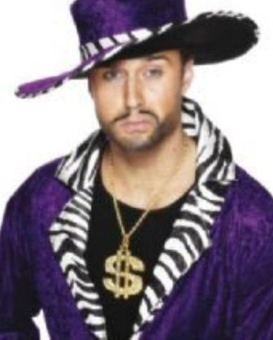
ACT Test Prep Rap
Performed by:
Iceman Tuck
The ACT
is a very big test (YO!)
Get yourself to bed early
So you can do your best
March 3 is the day
When you hit that bubble sheet
Come prepared and well fed
And your score can’t be beat!

Slide 3

WORD UP!

Slide 4
...And it can only get better from here...

Slide 5
The ACT
The ACT® test assesses high school students' general educational development and their ability to complete college-level work.
The multiple-choice tests cover four skill areas: English, Mathematics, Reading, and Science.

Slide 6
ACT Purpose:
For students:
To advise students about their academic standing statewide and nationwide
To identify academic areas of strength and weakness
For colleges and universities:
To determine a student’s potential academic performance/success in college

Slide 7

ACT and SAT:
Use by Colleges/Universities
Admission
Used in conjunction with class rank, GPA, admission essays
Scholarships
Many universities have one application for university scholarships

Slide 8
Scores:
36 Point Scale
  33+ is 99th percentile (91.667)
  20 is 53rd percentile (55.556)

Slide 9
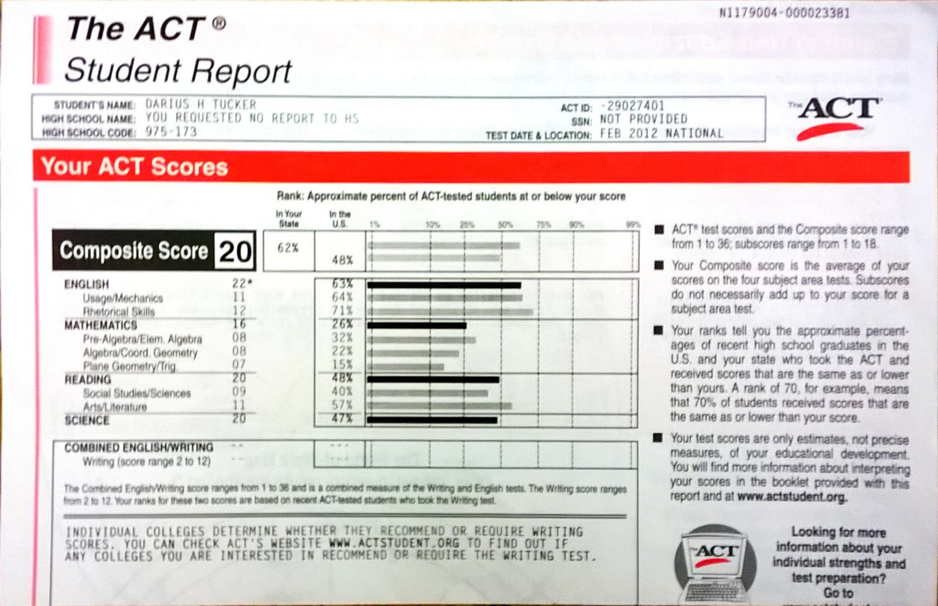

Slide 10

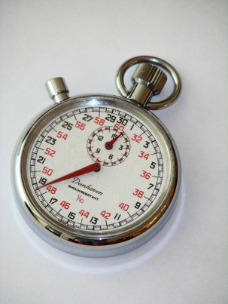
ACT: Test Structure
English Section
Measures standard written English and rhetorical skills
75 questions
45 minutes

Slide 11


ACT: English section
The test consists of five prose passages, each one accompanied by multiple-choice test questions. Different passage types are included to provide variety.
Questions ask about an underlined portion, a section of the passage, or the passage as a whole.
Many questions include "NO CHANGE" to the underlined portion or the passage as one of the choices.
www.act.org

Slide 12
Structure
75 questions
  Usage/Mechanics: 40
    Punctuation: 10
    Basic Grammar and Usage: 12
    Sentence Structure: 18
  Rhetorical Skills 35
    Strategy: 12
    Organization: 11
    Style: 12
5 Selections
45 Minutes

Slide 13
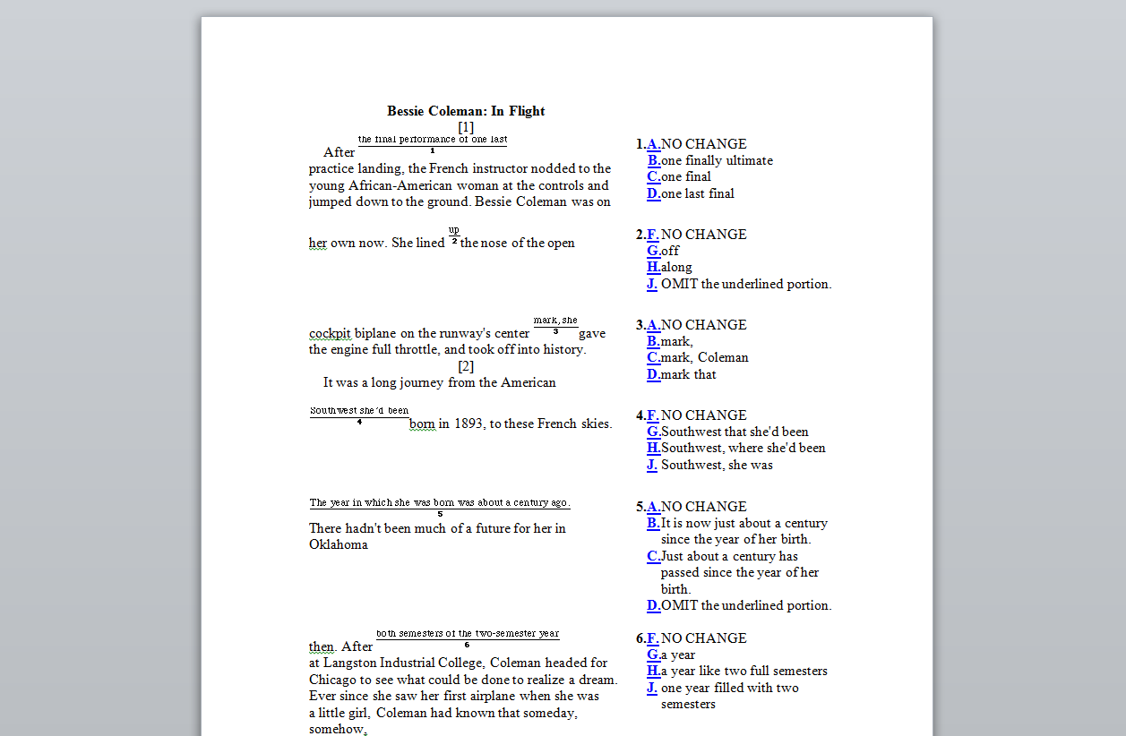

Slide 14
3: ACT Loves Verb Tense
Look at the big picture; determine from the whole selection the verb tense.
Does the questioned section deviate from that?

Slide 15
4: ACT Loves Antecedents
Look at the big picture; know the nouns to which pronouns refer back.
His/Her versus Their
Beginning sentences/paragraphs with pronouns is usually wrong.

Slide 16
ACT: Test Structure
Reading Section
Measures reading comprehension
Four passages
40 questions
35 minutes
www.act.org

Slide 17
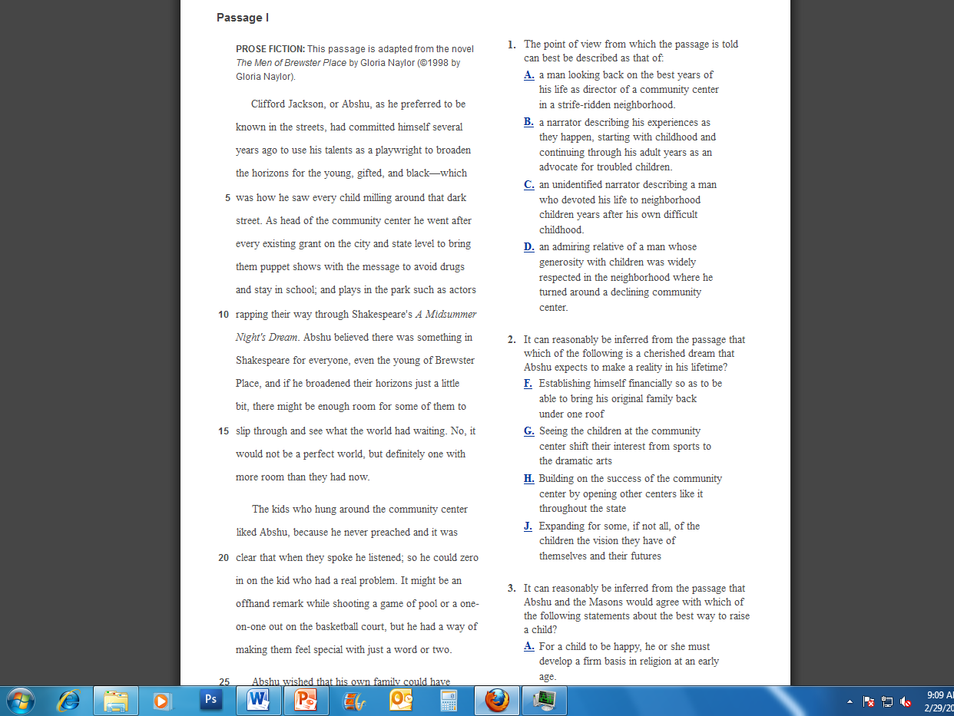

Slide 18

ACT: Reading Section
Questions ask students to use referring and reasoning skills to:
determine main ideas
locate and interpret significant details
understand sequences of events
make comparisons
comprehend cause-effect relationships
determine the meaning of context-dependent words, phrases, and statements
draw generalizations
analyze the author's or narrator's voice and method
www.act.org

Slide 19
ACT: Reading Section
The test comprises of four passages that are representative of the level and kind of reading required in first-year college courses; passages on topics in social studies, natural sciences, prose fiction, and the humanities are included.

Slide 20
Determine Purpose
What is the selection about?
For whom is this written?
What does this selection hope to achieve?
  Inform
  Persuade
  Entertain
How formal is the tone?

Slide 21
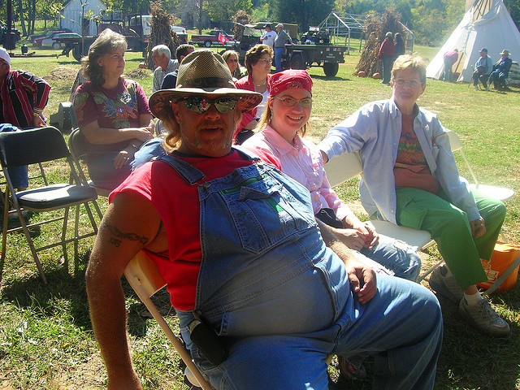
The ACT Test Overall

Slide 22

ACT: Testing Tips
Carefully read the instructions on the cover of the test booklet. Also, listen to the test administrator!
Read the directions for each test carefully. Being familiar with test structure lessens the time needed for this!
Read each question
carefully.

Slide 23
ACT: Testing Tips
Pace yourself—don't spend too much time on a single passage or question.
Pay attention to the announcement of five minutes remaining on each test.

Slide 24

ACT: Testing Tips
Answer the easy questions first, then go back and answer the more difficult ones if you have time remaining on that test.
(Star skipped questions in the booklet in the side margins.)
On difficult questions, eliminate as many incorrect answers as you can, then make an educated guess among those remaining.

Slide 25

ACT: Testing Tips
Answer every question. Your scores on the multiple-choice tests are based on the number of questions you answer correctly. There is no penalty for guessing.
Answer first and last questions in English and Math sections. The first 10-15 and last 10-15 questions in these sections are generally easier than the middle questions.

Slide 26



ACT Website
www.actstudent.org
Did you write it down yet?

Slide 27
ACT: Scores
ACT scores range from
36 to 11
Highest score is a 36
About 4% of students score higher than 30
From 2008-2012 the average score was 21

Slide 28
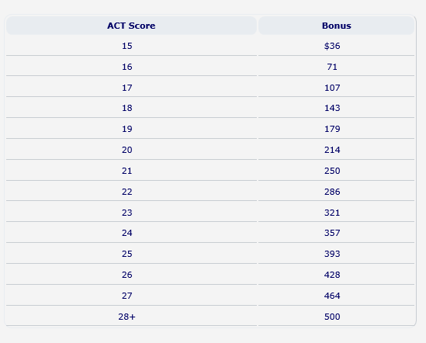
Good News!
You get KEES money for good scores.

Slide 29

You can get college credit for a strong test score in English:
Good News!
If you get a 29 or higher in the English portion of the test, WKU will give you credit for ENG 100. That’s the same as money in your pocket…

Slide 30
ACT: How Many Times?
Take at least twice.
Statistics show that on average students improve 1-2 points on the ACT.

Slide 31
ACT: Test Day Tips
Get a good night’s sleep!
BE ON TIME!!!!! 8:15
Eat a good breakfast.
Turn off cell phone.
Bring a watch for time keeping.

Slide 32
WORD UP!

Slide 33
ACT Tips

Slide 34


On ACT day, you should wear a watch. If you don’t own one of these mysterious thingamabobs, maybe you can borrow one from a parent.
Turn your cell phone OFF. Yeah, like power down. The ACT is not joking about their policy on noises during their tests.

Slide 35
Helpful Tips for Students
Answer every question—there is no penalty for guessing
Answer the easier questions first—go back to the hard ones. Remember, after a second glance, CIRCLE and SKIP if you don’t know the answer
Pay attention to subtle differences in answer choices
Use process of elimination

Slide 36
The Reading Test

Slide 37
The Facts
On the actual ACT, the reading portion of the test is four passages with ten questions each
You will have 35 minutes to complete this section
The passages cover history, science, prose, and humanities

Slide 38
The four ACT Reading passages will always be arranged in this set order: Prose Fiction, Social Science, Humanities, and Natural Science.
However, this doesn't mean that you have to read the passages in that order.

Slide 39
Choose the passage that's easiest to read first. For instance, if you happen to like stories, then stick with Prose Fiction first. If you feel like fiction passages and questions are tougher for you than anon-fiction piece, then skip the prose passage and save it for last.

Slide 40
Skills Used
Inference
Reading comprehension
Main idea
Supporting details
Vocabulary
Generalizations
Cause and effect relationships
Sequence of events

Slide 41
Skills (cont.)
What does it mean when they ask for the best answer?
Process of elimination with vocab is extremely helpful
Read the passage—you cannot look for details if you don’t actually read it.
ANNOTATE the PASSAGE!
-Underline, star, or otherwise mark parts that seem important. Things like main ideas and supporting details.

Slide 42
Annotation
Students may write on the passages anywhere they like
For this reason, two types of annotation are often suggested:
  Underline and star anything that sounds like a main idea sentence
  Underline specific details/facts that support the main idea(s).
  Circle any words you don’t know
  Underline anything that might indicate audience and/or purpose
  Students may add other notations if they find they are helpful

Slide 43
ID the Verb
You need to look and see what specifically the verb is asking you to do in the question
  Conclude, Infer, Compare, etc.

Slide 44
The English Test

Slide 45
Basic Info
The English test is divided into five passages, each with about 15 questions.
45 minutes for 75 questions
This averages out to about 30 seconds per question. Word!
However, some questions will be easier than others, allowing students to spend more time on the difficult ones
A word, phrase, or sentence will be underlined and there will be four options for correcting it

Slide 46
English Test Skills
Wordiness—the wrong answers are often wrong because they are too wordy. The long, complicated, sophisticated-sounding answers are WRONG most of the time. Just remember: NO SHAKESPEARE!
Also, if the wording is concise but just “sounds” off—chopped or flip-flopped—then it’s probably not the correct simple answer.
Just remember: NO YODA!

Slide 47
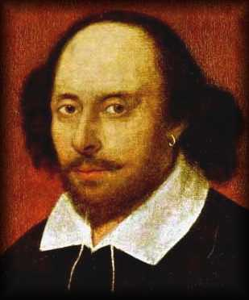
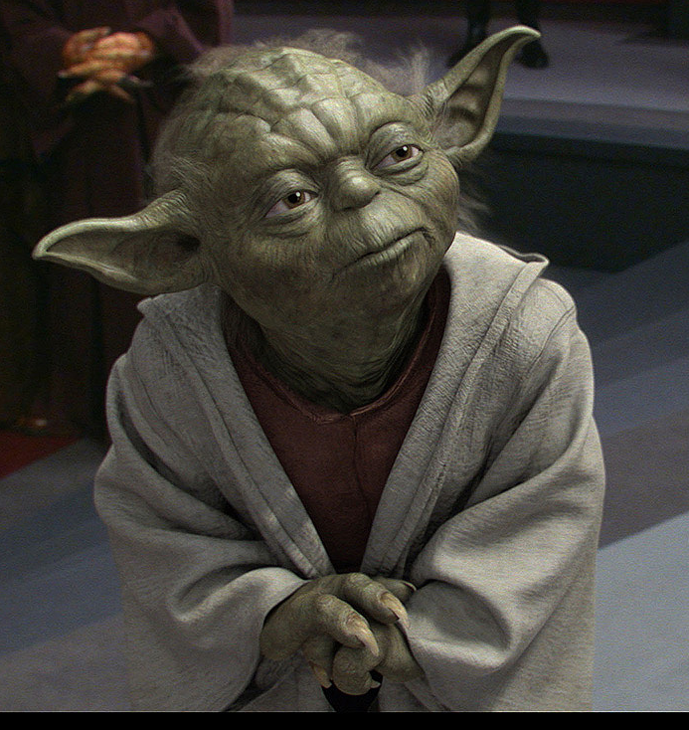
REMEMBER:

Slide 48
The shortest answer is not always, but is often, the right choice
We want the clearest, most straightforward answer we can get
No more, no less
When you are in complete doubt at your return look at questions, instead of wasting precious time, you should pick the shortest answer on the English test and move on
Questions that are long and seem complicated are ones students will often just guess on—you need to understand these are often quite easy. Pace yourself!

Slide 49
Skills cont.
Redundancy—the test looks for students’ abilities to identify redundant information
We want no more, no less information than we need to get the point across
Generally, the answer should sound like someone would talk. Well, someone with a basic, educated grasp on the English language…

Slide 50
Irrelevance—you will also be tested on whether or not information is relevant exactly where it is placed
While it might be relevant in paragraph 2, we don’t want it if we’re answering something about paragraph 5
This also gets into organization, which you will be questioned on, as well

Slide 51
Punctuation and Agreement
More than anything, students will encounter subject/verb agreement, pronoun/antecedent agreement, verb tense, and punctuation questions
You need to know to look for the subtle differences, like one answer choice offers a comma, one a semicolon, one a colon, and the last a period
You will also get questions about apostrophes

Slide 52
RANDOM Tricks of the Test
Many times, an answer with a colon in it will not be correct. (Not always, but if you are guessing or using process of elimination.)
The more commas in an answer choice, the more likely it is that it’s wrong
OMIT is always the shortest answer choice (although that doesn’t mean it’s correct)
If it sounds really complicated, it’s probably too complicated to be correct

