Slide 1
FUN FUN TIME!
Today begins the journey of your creation.
Before we get into that, though, think back to when you were younger…

Slide 2
NOPE—Younger Than That…

Slide 3
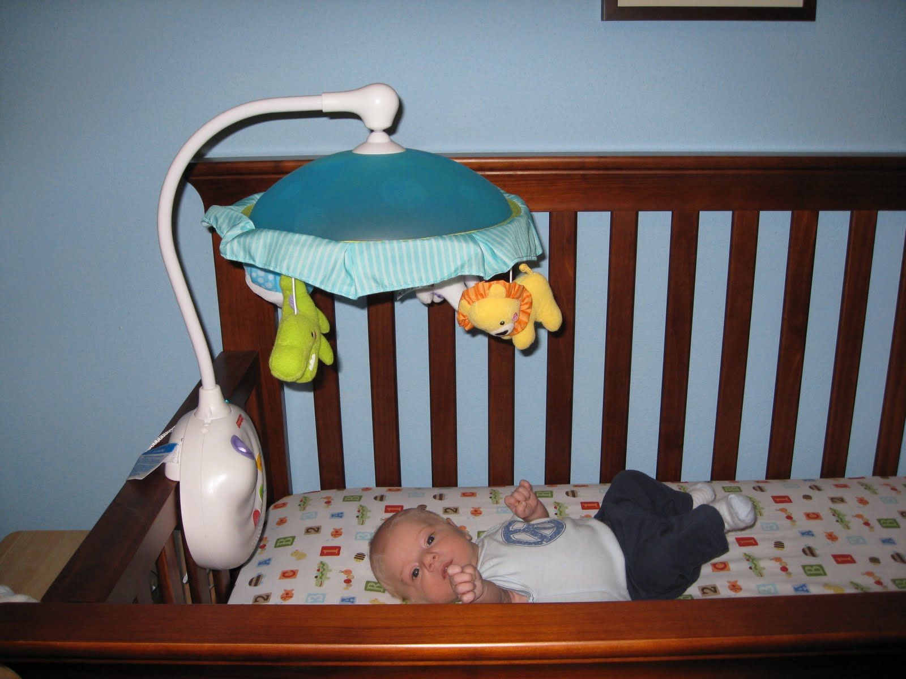
MORE LIKE THIS…
AHHHHHHHHHH…

Slide 4
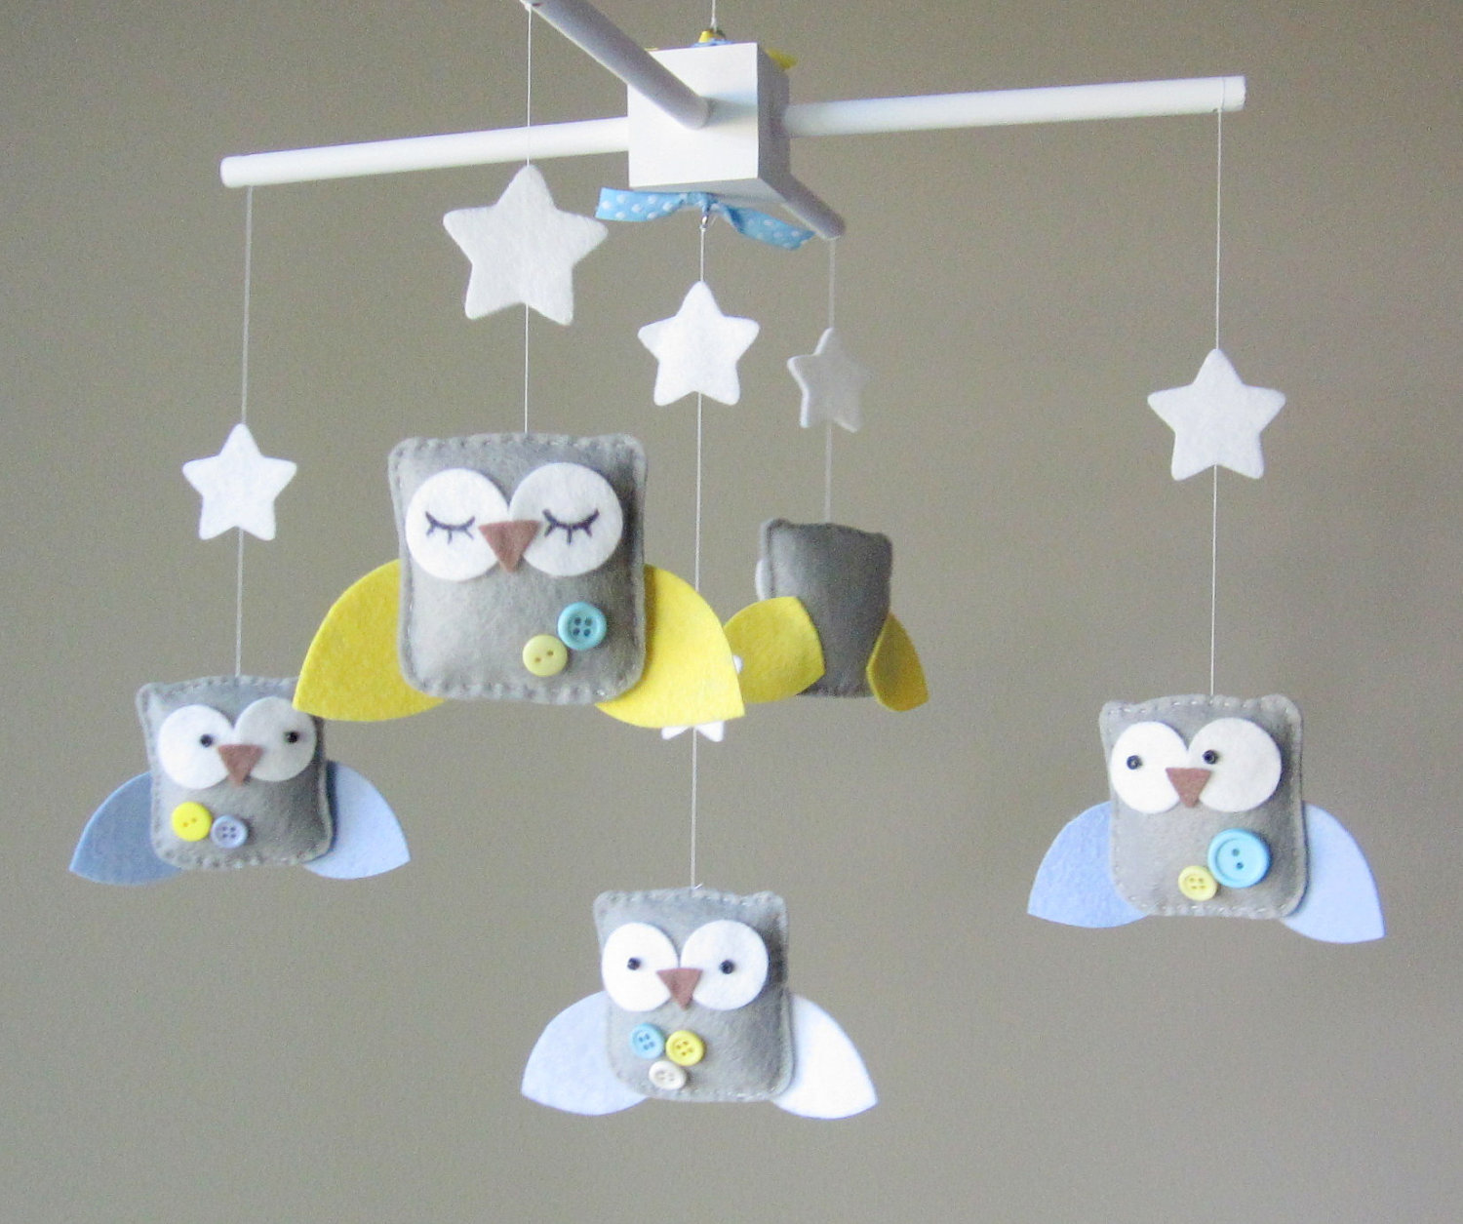
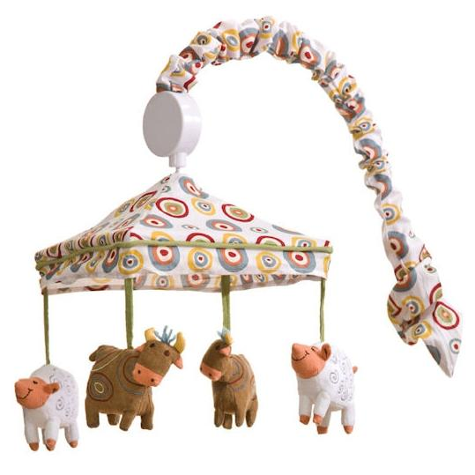
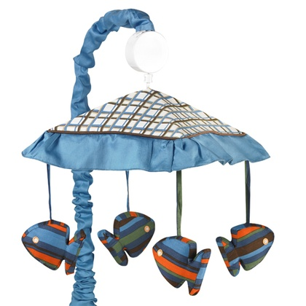
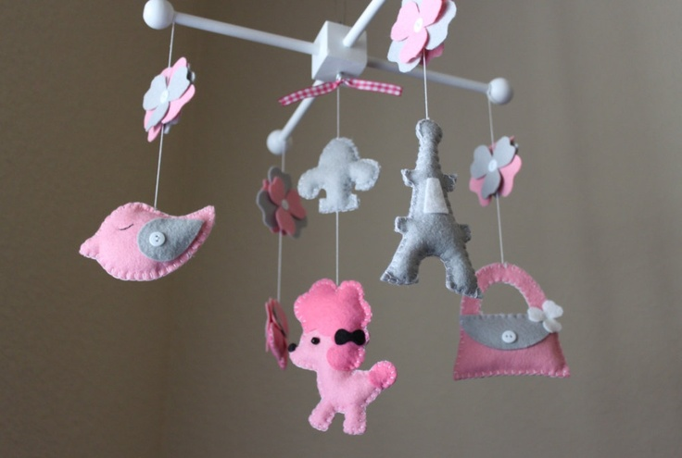
You probably don’t remember the crib…or anything from your first two or three years of life. However, you all probably know what a baby mobile is.

Slide 5
You will be creating a mobile for our next unit of study. Not a baby mobile, though. Instead of cute little animals or fuzzy little stars, your mobile will be focused on a topic and geared for a bit of an older audience than babies. (Though just as smelly…) You will select a topic form the list Mr. Tucker has. First come, first served. All of the options have something to do with the 1960s. You are going to research the topic you select, create info cards of need-to-know info regarding the topic, and create a mobile.

Slide 6
The Details:
It must contain 5 information “cards”
On one side of each card is a factoid for a specific aspect of your topic
On the other side of each card is a picture that goes with that info
The mobile must contain a “title” that is hangs either above or below the info cards
Cards are a minimum of 4”x6” and should be thicker than just paper
The information should be clear and concise
The mobile should resemble a real mobile—do NOT simply hang some notecards from a coat hanger! The shape/design/etc. is up to you, though
The mobile must contain at least four different colors on it
The mobile should look clean, creative, attractive, and the information should be clearly visible and legible
BE CREATIVE!

Slide 7
AN Example:

Slide 8
THE TOPICS:
The Beatles
Motown
Bob Dylan
The Hippie movement
Watts Riots
Muscle Car craze of the 60s
Cuban Missile Crisis
Fashion of the 60s
TV and Movies of the 60s
The Black Panthers
The Space Race
Cesar Chavez
1962 Ruling on prayer in school
Native American protests of the 60s
Freedom Riders
Sports highlights of the 60s
Woodstock
Vietnam War Protests
Vietnam War Objectives and Criticisms
Vietnam War Crimes by US Soldiers
The Draft
Assassination of President Kennedy
Assassination of Malcolm X
Assassination of Dr. King
Assassination of Robert Kennedy
Mississippi Burning Trial
Greensboro Sit-Ins
School Integration
March on Washington
Ralph Nader and the Consumer Movement

